Slide 1
Murach’s PHP and MySQL (4th Edition)
Chapter 17
How to use SQL
to create a database

Slide 2
Applied objectives
Given the design for a database, create a SQL script that will create the database, including all tables, primary keys, foreign key constraints, and indexes.
Use SQL statements to create users and assign privileges to the users.
Load data into a database table from a text file.
Dump a database to a SQL script.

Slide 3
Knowledge objectives
Describe the use of the DDL statements for creating, altering, and dropping databases, tables, and indexes.
Describe the column definitions for a table in terms of data types and these attributes: unique, not null, default, primary key, auto-increment, and references. Also, describe a table-level definition for a primary key and a foreign key constraint.
Describe the use of the DDL statements for creating, renaming, and dropping users and for assigning and revoking privileges.
Describe the process of loading data from a text file into a table, and the process of dumping a database to a SQL script.
Describe the use of a script for creating a database.

Slide 4
How to create a database
CREATE DATABASE my_guitar_shop2;
How to create a database only if it does not exist
CREATE DATABASE IF NOT EXISTS my_guitar_shop2;
How to select a database
USE my_guitar_shop2;
How to drop a database
DROP DATABASE my_guitar_shop2;
How to drop a database only if it exists
DROP DATABASE IF EXISTS my_guitar_shop2;

Slide 5
Common numeric data types
INT[(size)]
TINYINT[(size)]
DECIMAL[(p[,s])]
Common string data types
VARCHAR(size)
CHAR[(size)]
TEXT
Common date and time data types
DATE
TIME
DATETIME

Slide 6
The syntax of the CREATE TABLE statement
CREATE TABLE [IF NOT EXISTS] tableName
(
columnName1 dataType [columnAttributes][,
columnName2 dataType [columnAttributes]][,
columnName3 dataType [columnAttributes]]...
)
Three common column attributes
UNIQUE
NOT NULL
DEFAULT default_value

Slide 7
A table without column attributes
CREATE TABLE customers
(
customerID INT,
firstName VARCHAR(60),
lastName VARCHAR(60)
);
A table with column attributes
CREATE TABLE customers
(
customerID INT NOT NULL UNIQUE,
firstName VARCHAR(60) NOT NULL,
lastName VARCHAR(60) NOT NULL
);

Slide 8
Another table with column attributes
CREATE TABLE orders
(
orderID INT NOT NULL UNIQUE,
customerID INT NOT NULL,
orderNumber VARCHAR(50) NOT NULL,
orderDate DATE NOT NULL,
orderTotal DECIMAL(9,2) NOT NULL,
paymentTotal DECIMAL(9,2) DEFAULT 0
);

Slide 9
Two column attributes for working with a primary key
PRIMARY KEY
AUTO_INCREMENT
A table with a column-level primary key
CREATE TABLE customers (
customerID INT NOT NULL PRIMARY KEY
AUTO_INCREMENT,
emailAddress VARCHAR(255) NOT NULL UNIQUE
);
A table with a table-level primary key
CREATE TABLE customers (
customerID INT NOT NULL AUTO_INCREMENT,
emailAddress VARCHAR(255) NOT NULL UNIQUE,
PRIMARY KEY (customerID)
);

Slide 10
A table with a two-column primary key
CREATE TABLE orderItems (
orderID INT NOT NULL,
productID INT NOT NULL,
itemPrice DECIMAL(10,2) NOT NULL,
discountAmount DECIMAL(10,2) NOT NULL,
quantity INT NOT NULL,
PRIMARY KEY (orderID, productID)
);

Slide 11
Three attributes for working with a foreign key
CONSTRAINT
FOREIGN KEY
REFERENCES
A table with a column-level foreign key constraint
CREATE TABLE orders
(
orderID INT PRIMARY KEY,
customerID INT NOT NULL
REFERENCES customers (customerID),
orderDate DATETIME NOT NULL
)

Slide 12
A table with a table-level foreign key constraint
CREATE TABLE orders
(
orderID INT PRIMARY KEY,
customerID INT NOT NULL,
orderDate DATETIME NOT NULL,
CONSTRAINT ordersFkCustomers
FOREIGN KEY (customerID)
REFERENCES customers (customerID)
)

Slide 13
An INSERT statement that fails because a related row doesn’t exist
INSERT INTO orders
VALUES (1, 999, '2022-04-03')
The response from the system
Error Code: 1452. Cannot add or update a child row: a foreign key constraint fails ('ex'.'orders', CONSTRAINT 'ordersFkCustomers' FOREIGN KEY ('customerID') REFERENCES 'customers' ('customerID'))
A constraint that uses the ON DELETE clause
CONSTRAINT ordersFkCustomers
FOREIGN KEY (customerID)
REFERENCES customers (customerID)
ON DELETE CASCADE

Slide 14
A statement that renames a table
ALTER TABLE products RENAME TO product;
A statement that adds a new column
at the end of the table
ALTER TABLE customers ADD lastTransactionDate DATE;
A statement that adds a new column
after a specified column
ALTER TABLE customers ADD lastTransactionDate DATE
AFTER emailAddress;
A statement that drops a column
ALTER TABLE customers DROP lastTransactionDate;
A statement that renames a column
ALTER TABLE customers
CHANGE emailAddress email VARCHAR(255) NOT NULL UNIQUE;

Slide 15
A statement that changes a column definition
ALTER TABLE customers MODIFY firstName VARCHAR(100) NOT NULL;
A statement that changes a column’s data type
ALTER TABLE customers MODIFY firstName CHAR(100) NOT NULL;
A statement that may cause data to be lost
ALTER TABLE customers MODIFY firstName VARCHAR(8);
A statement that sets a column’s default value
ALTER TABLE customers ALTER firstName SET DEFAULT '';
A statement that drops a column’s default value
ALTER TABLE customers ALTER firstName DROP DEFAULT;
Warning
You should never alter a table or other database object in a production database without first consulting the DBA.

Slide 16
A statement that drops a table
DROP TABLE customers;
A statement that drops a table if it exists
DROP TABLE IF EXISTS customers;
Warning
You should never drop a table in a production database without first consulting the DBA, but you probably won’t have the privileges for doing that.

Slide 17
The syntax of the CREATE INDEX statement
CREATE [UNIQUE] INDEX|KEY indexName
ON tableName (columnName1 [ASC|DESC]
[, columnName2 [ASC|DESC]]...)
A statement that…
Creates an index based on a single column
CREATE INDEX customerID
ON orders (customerID);
Creates a unique index
CREATE UNIQUE INDEX emailAddress
ON customers (emailAddress);
Creates an index based on two columns
CREATE UNIQUE INDEX customerIDorderNumber
ON orders (customerID, orderNumber);
Creates an index that’s sorted in descending order
CREATE INDEX orderTotal
ON orders (orderTotal DESC);

Slide 18
A CREATE TABLE statement that creates indexes
CREATE TABLE customers (
customerID INT NOT NULL AUTO_INCREMENT,
emailAddress VARCHAR(255) NOT NULL,
firstName VARCHAR(60) NOT NULL,
PRIMARY KEY (customerID),
UNIQUE INDEX emailAddress (emailAddress),
INDEX firstName (firstName)
);
A DROP INDEX statement that drops an index
DROP INDEX firstName ON customers;

Slide 19
Privileges for working with data
SELECT
INSERT
UPDATE
DELETE
Privileges for modifying the database structure
CREATE
ALTER
DROP
INDEX
Other privileges
CREATE USER
ALL [PRIVILEGES]
GRANT OPTION

Slide 20
The four privilege levels
Level | Example
Global | *.*
Database | music_db.*
Table | music_db.products
Column | (listPrice) music_db.products

Slide 21
How to create a user from a specific host
CREATE USER joel@localhost IDENTIFIED BY 'sesame';
How to create a user from any host
CREATE USER dba IDENTIFIED BY 'sesame';
How to create a user only if it does not exist
CREATE USER IF NOT EXISTS joel@localhost
IDENTIFIED BY 'sesame';
How to rename a user from a specific host
RENAME USER joel@localhost TO joelmurach@localhost;
How to change a user’s password
ALTER USER joelmurach@localhost
IDENTIFIED BY 'newpassword';

Slide 22
How to drop a user from a specific host
DROP USER joelmurach@localhost;
How to drop a user from any host
DROP USER dba;
How to drop a user only if it exists
DROP USER IF EXISTS joelmurach@localhost;

Slide 23
The syntax of the GRANT statement
GRANT privilegeList
ON [dbName.]table
TO user1 [, user2]...
[WITH GRANT OPTION]
A statement that grants table privileges
GRANT SELECT, INSERT, UPDATE
ON my_guitar_shop2.products TO joel@localhost;
A statement that grants database privileges
GRANT SELECT, INSERT, UPDATE
ON my_guitar_shop2.* TO joel@localhost;
A statement that grants global privileges
GRANT SELECT, INSERT, UPDATE
ON *.* TO joel@localhost;

Slide 24
A statement that grants column privileges
GRANT SELECT (productCode, productName, listPrice), UPDATE (description)
ON my_guitar_shop2.products TO joel@localhost
A statement that uses the current database
GRANT SELECT, INSERT, UPDATE, DELETE
ON customers TO joel@localhost;
A statement that grants all privileges
GRANT ALL
ON *.* TO dba WITH GRANT OPTION;

Slide 25
The syntax of the REVOKE statement for all privileges
REVOKE ALL[ PRIVILEGES], GRANT OPTION
FROM user1 [, user2]...
A statement that revokes all privileges from a user
REVOKE ALL, GRANT OPTION
FROM dba;
A statement that revokes all privileges
from multiple users
REVOKE ALL, GRANT OPTION
FROM dba, joel@localhost;

Slide 26
The syntax of the REVOKE statement for specific privileges
REVOKE privilegeList
ON [dbName.]table
FROM user [, user]
A statement that revokes specific privileges
from a user
REVOKE UPDATE, DELETE
ON my_guitar_shop2.customers FROM joel@localhost

Slide 27
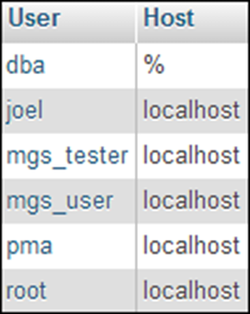
A statement that lists all users
SELECT User, Host from mysql.user;
The result set

Slide 28
The syntax of the SHOW GRANTS statement
SHOW GRANTS [FOR user]
A statement that shows the privileges
for a user from any host
SHOW GRANTS FOR dba;
The result set

Slide 29
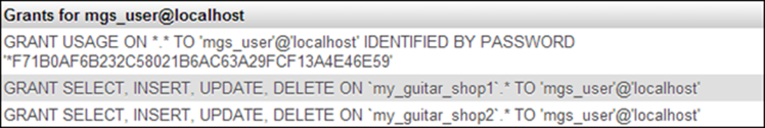
A statement that shows the privileges for a user from a specific host
SHOW GRANTS FOR mgs_user@localhost;
The result set
A statement that shows the privileges
for the current user
SHOW GRANTS;

Slide 30
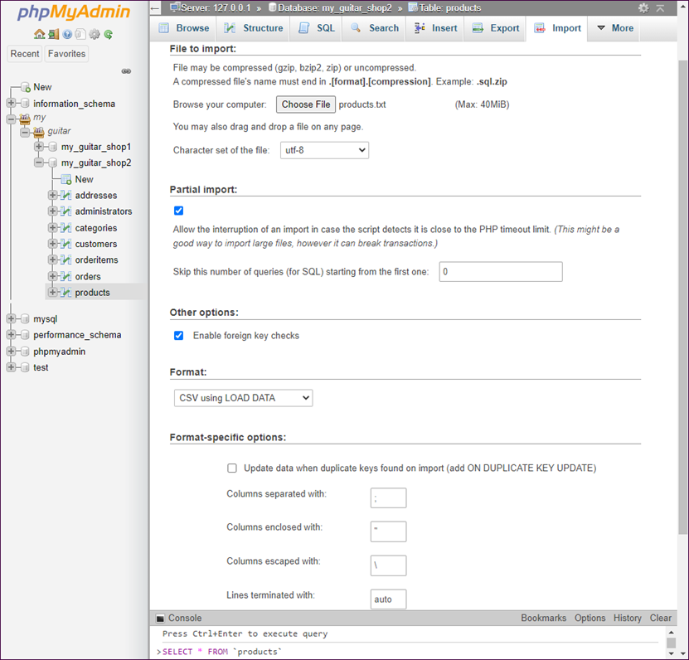
The Import tab for the table named products

Slide 31
A tab-delimited text file that’s stored in users.txt
1 John Smith jsmith@gmail.com
2 Andrea Steelman andi@murach.com
3 Joel Murach joelmurach@yahoo.com
Using phpMyAdmin to load data from a text file
Start phpMyAdmin, select the database, select the table, and click on the Import tab.
Select the file to import.
Set the options for the import and click the Go button. If you get an error, you can modify the import options and try again.

Slide 32
How to use the command prompt to load data from a text file
cd /xampp/mysql/bin
mysql -u root -p
Enter password: ******
use my_guitar_shop2;
load data local infile "/murach/products.txt" into table products;
exit;

Slide 33
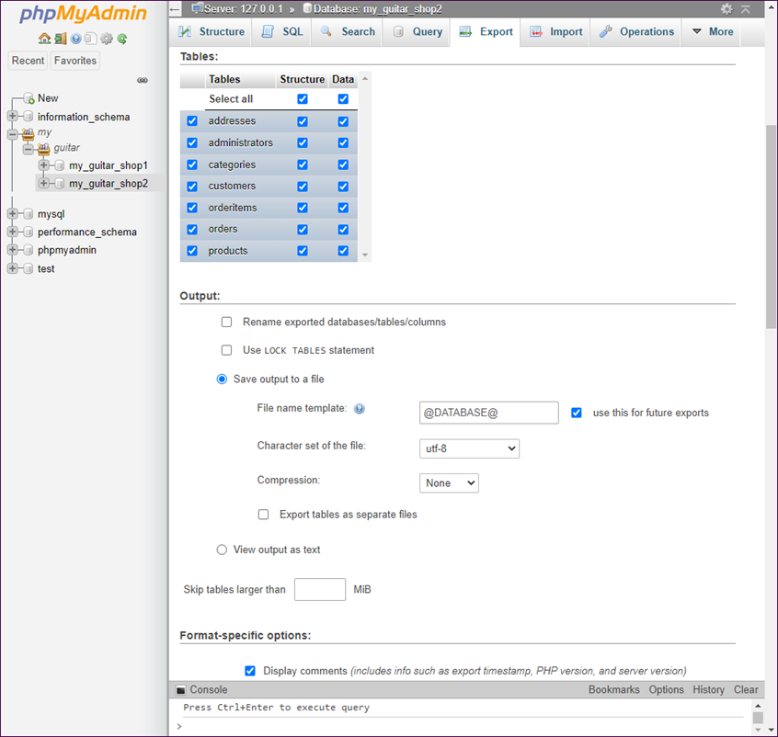
The Export tab for my_guitar_shop2

Slide 34
How to use phpMyAdmin to dump a database
Start phpMyAdmin, select the database, and click on the Export tab.
Set the options for the SQL script file.
Click on the Go button and save the file.
How to use the command prompt
to dump a database to a SQL script
cd /xampp/mysql/bin
mysqldump -u root -p my_guitar_shop2 > my_guitar_shop2.sql
Enter password: ******

Slide 35
The SQL script that creates the my_guitar_shop2 database (part 1)
-- create and select the database
DROP DATABASE IF EXISTS my_guitar_shop2;
CREATE DATABASE my_guitar_shop2;
USE my_guitar_shop2;
-- create the tables for the database
CREATE TABLE customers (
customerID INT NOT NULL
AUTO_INCREMENT,
emailAddress VARCHAR(255) NOT NULL,
password VARCHAR(60) NOT NULL,
firstName VARCHAR(60) NOT NULL,
lastName VARCHAR(60) NOT NULL,
shipAddressID INT DEFAULT NULL,
billingAddressID INT DEFAULT NULL,
PRIMARY KEY (customerID),
UNIQUE INDEX emailAddress (emailAddress)
);

Slide 36
The SQL script that creates the database (part 2)
CREATE TABLE addresses (
addressID INT NOT NULL
AUTO_INCREMENT,
customerID INT NOT NULL,
line1 VARCHAR(60) NOT NULL,
line2 VARCHAR(60) DEFAULT NULL,
city VARCHAR(40) NOT NULL,
state VARCHAR(2) NOT NULL,
zipCode VARCHAR(10) NOT NULL,
phone VARCHAR(12) NOT NULL,
disabled TINYINT(1) NOT NULL DEFAULT 0,
PRIMARY KEY (addressID),
INDEX customerID (customerID)
);

Slide 37
The SQL script that creates the database (part 3)
CREATE TABLE orders (
orderID INT NOT NULL
AUTO_INCREMENT,
customerID INT NOT NULL,
orderDate DATETIME NOT NULL,
shipAmount DECIMAL(10,2) NOT NULL,
taxAmount DECIMAL(10,2) NOT NULL,
shipDate DATETIME DEFAULT NULL,
shipAddressID INT NOT NULL,
cardType INT NOT NULL,
cardNumber CHAR(16) NOT NULL,
cardExpires CHAR(7) NOT NULL,
billingAddressID INT NOT NULL,
PRIMARY KEY (orderID),
INDEX customerID (customerID)
);

Slide 38
The SQL script that creates the database (part 4)
CREATE TABLE orderItems (
itemID INT NOT NULL
AUTO_INCREMENT,
orderID INT NOT NULL,
productID INT NOT NULL,
itemPrice DECIMAL(10,2) NOT NULL,
discountAmount DECIMAL(10,2) NOT NULL,
quantity INT NOT NULL,
PRIMARY KEY (itemID),
INDEX orderID (orderID),
INDEX productID (productID)
);

Slide 39
The SQL script that creates the database (part 5)
CREATE TABLE products (
productID INT NOT NULL
AUTO_INCREMENT,
categoryID INT NOT NULL,
productCode VARCHAR(10) NOT NULL,
productName VARCHAR(255) NOT NULL,
description TEXT NOT NULL,
listPrice DECIMAL(10,2) NOT NULL,
discountPercent DECIMAL(10,2) NOT NULL DEFAULT 0.00,
dateAdded DATETIME NOT NULL,
PRIMARY KEY (productID),
INDEX categoryID (categoryID),
UNIQUE INDEX productCode (productCode)
);
CREATE TABLE categories (
categoryID INT NOT NULL
AUTO_INCREMENT,
categoryName VARCHAR(255) NOT NULL,
PRIMARY KEY (categoryID)
);

Slide 40
The SQL script that creates the database (part 6)
CREATE TABLE administrators (
adminID INT NOT NULL
AUTO_INCREMENT,
emailAddress VARCHAR(255) NOT NULL,
password VARCHAR(255) NOT NULL,
firstName VARCHAR(255) NOT NULL,
lastName VARCHAR(255) NOT NULL,
PRIMARY KEY (adminID)
);
-- create the user
CREATE USER IF NOT EXISTS mgs_user@localhost
IDENTIFIED BY 'pa55word';
-- grant privileges to the user
GRANT SELECT, INSERT, UPDATE, DELETE
ON *
TO mgs_user@localhost;

